Slide 1

BLACK FRIDAY SALES PREDICTION
Exploratory Data Analysis
Presented by:
Yuktha Polagani
Batch:
[548_B]

Slide 2
Introduction & Problem Statement
Black Friday is one of the biggest shopping events, generating a large amount of customer transaction data.
This project analyzes Black Friday sales data to understand customer purchasing behaviour and identify factors associated with differences in purchase amounts.
The analysis focuses on:
Customer demographics
Product categories
City categories
Gender and age groups
Purchase amount patterns

Slide 3
Why This Project?
Why Black Friday Sales Analysis?
Black Friday generates a large volume of retail transactions.
The dataset provides information about customers, products and purchase amounts.
EDA helps identify purchasing patterns and customer behaviour.
The insights can help businesses better understand customer preferences and spending patterns.
This project is relevant to the Retail & E-Commerce domain.

Slide 4
Dataset Information
Dataset: Black Friday Sales Dataset
Source: Kaggle
Dataset Type: Retail / E-Commerce Transaction Data
Original Records: 550,068
Columns: 12
Main Outcome Variable: Purchase
Data Format: CSV
Dataset Description:
The dataset contains customer demographic information, product category details, city information and transaction-level purchase amounts.

Slide 5
Understanding the Dataset
Dataset Structure
Rows: 550,068
Columns: 12
Categorical Features: Gender, Age, City Category, Stay in Current City Years
Numerical Features: Occupation, Marital Status, Product Categories
Outcome Variable: Purchase
Key Features:
Customer information
Product information
City and demographic information
Transaction purchase amount
Feature | Description
user_id | Unique customer identifier
product_id | Product identifier
gender | Customer gender
age | Customer age group
city_category | City category
product_category_1 | Primary product category
product_category_2 | Additional product category
product_category_3 | Additional product category
purchase | Transaction purchase amount

Slide 6
Data Cleaning & Preparation
Before Cleaning
550,068 records
12 columns
Missing values present
2,677 purchase outliers identified
Data Quality Checks Performed
Column Names
Converted all column names to lowercase for consistency.
Missing Values
Missing values were found in product_category_2 and product_category_3.
Replaced missing values with 0, representing no additional product category recorded.
Duplicate Records
No duplicate records were found.
Outliers
Used the IQR method to identify outliers in purchase.
2,677 potential outlier records were removed.
Final dataset: 547,391 records
Class Imbalance
Not applicable because purchase is a continuous numerical variable.
After Cleaning
547,391 records
12 columns
No missing values
No duplicate records

Slide 7
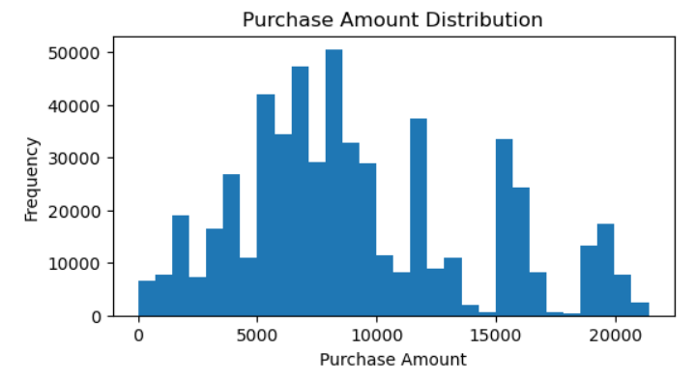
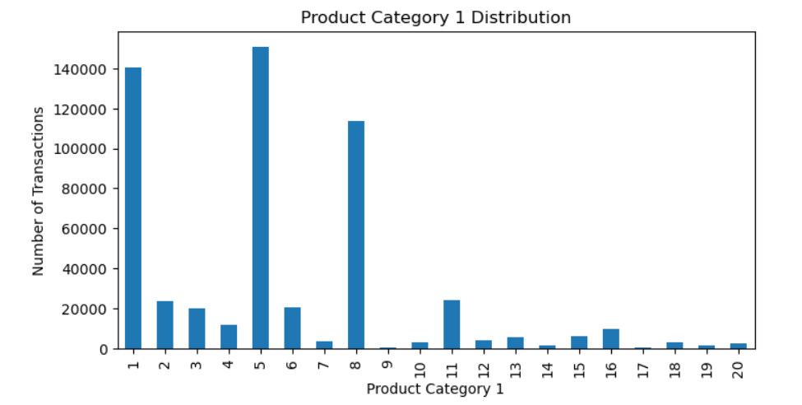
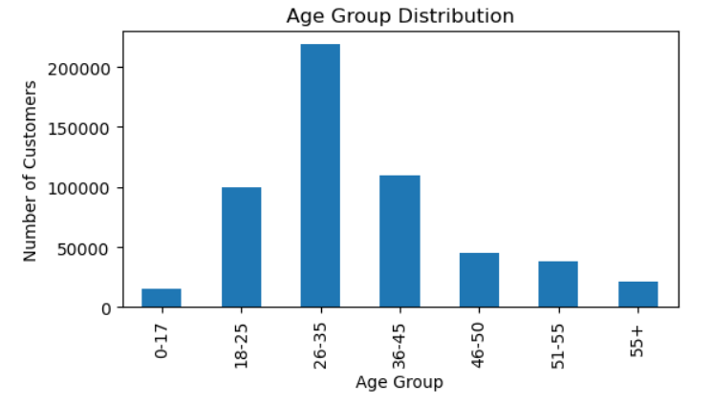
Univariate Analysis
1. Purchase Amount Distribution
2. Age Group Distribution
3. Product Category 1 Distribution
Key Observations
Purchase amounts show variation across different spending ranges.
The 26–35 age group has the highest representation.
Product Category 5 has the highest number of transactions.

Slide 8
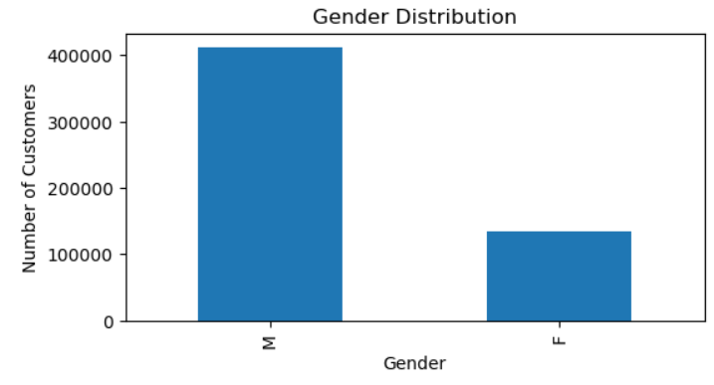
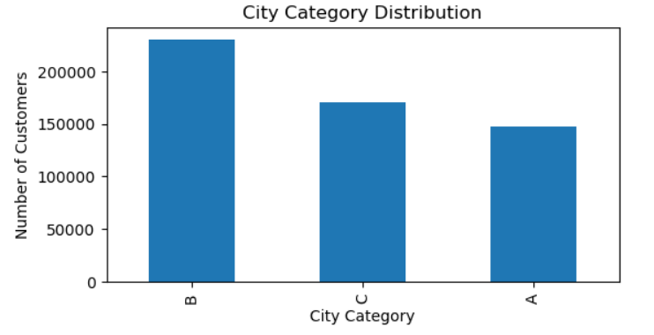
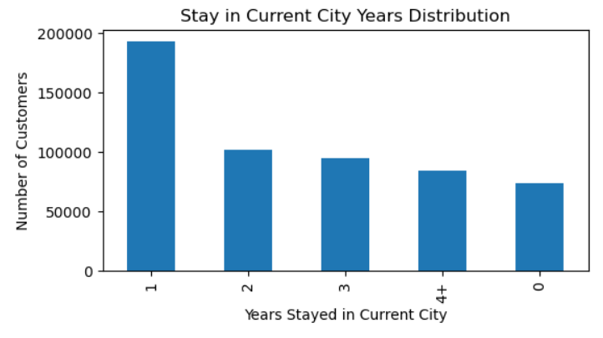
4. Gender Distribution
5. City Category Distribution
Key Observations
• Male customers have higher representation than female customers in the dataset.
• City Category B has the highest representation, followed by City Categories C and A.
• Customers who stayed in their current city for 1 year have the highest representation.
• The 4+ years and 0 years categories have comparatively lower representation.
6. Stay in Current City Years Distribution

Slide 9
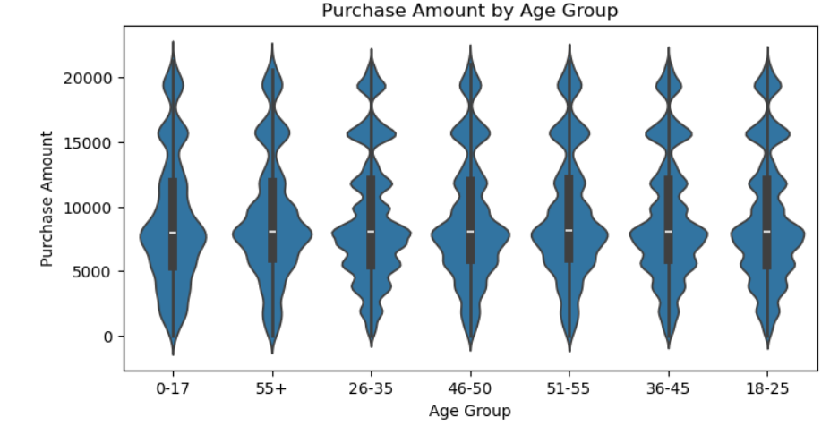
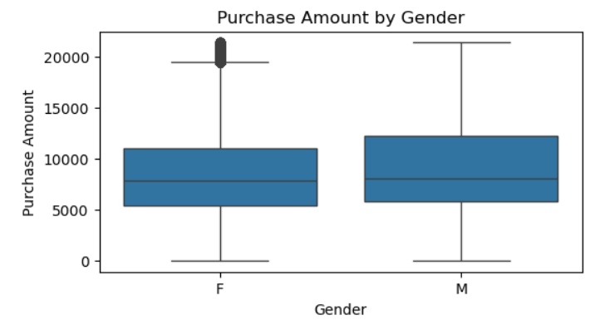
Bivariate Analysis
1. Purchase Amount by Gender
2. Purchase Amount by Age Group
Key Observations
Male and female purchase distributions are broadly similar, with the male median slightly higher.
Purchase amounts are distributed across all age groups, with differences in spread and density.

Slide 10
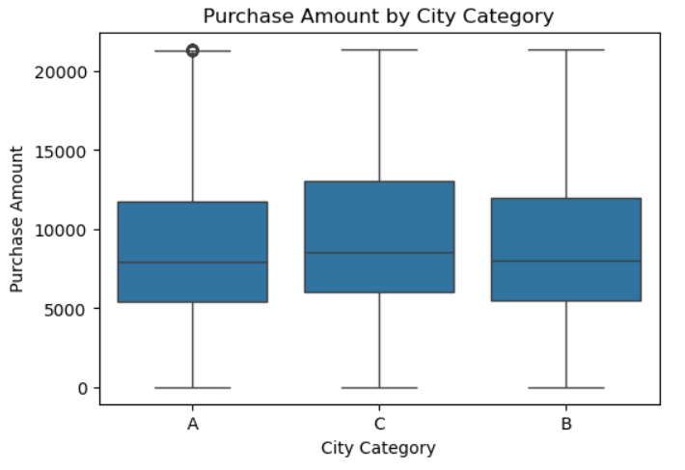
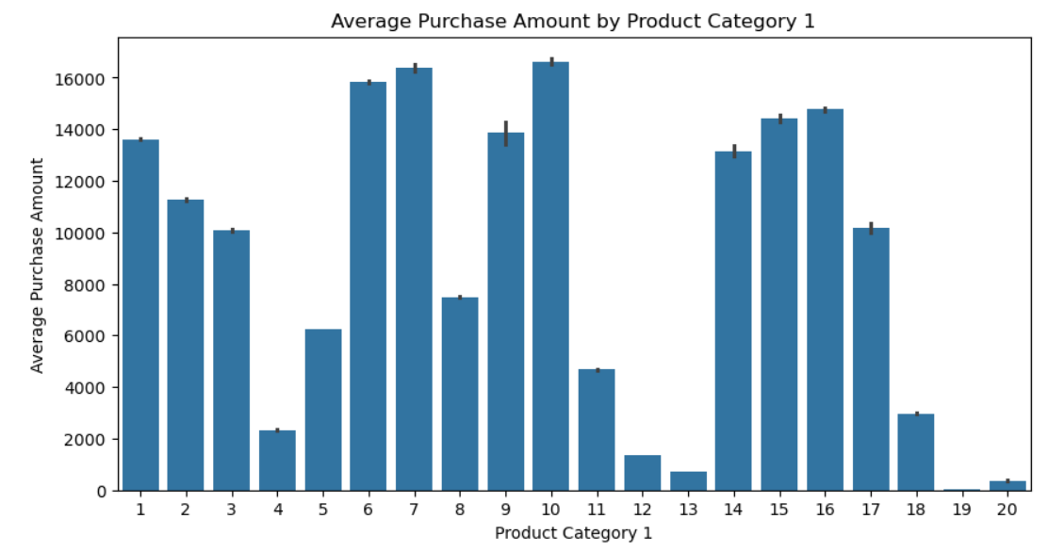
3. Purchase Amount by City Category
4. Average Purchase Amount by Product Category 1
Key Observations:
Purchase amount distributions across City Categories A, B and C are broadly similar.
City Category C has a slightly higher median purchase amount.
Average purchase amounts vary considerably across Product Category 1.
Categories 6, 7, 10, 15 and 16 show relatively high average purchase amounts.

Slide 11
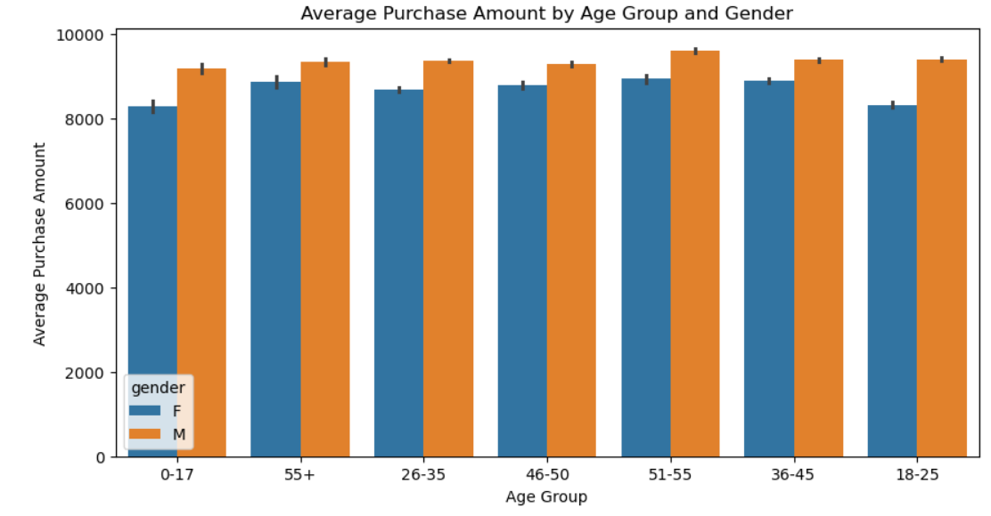
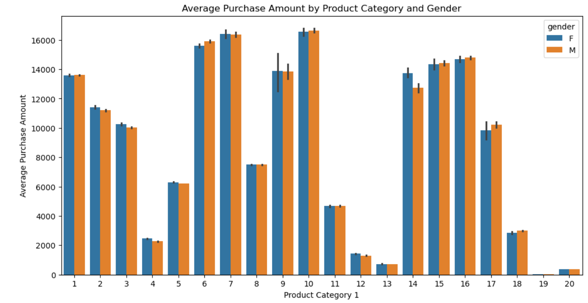
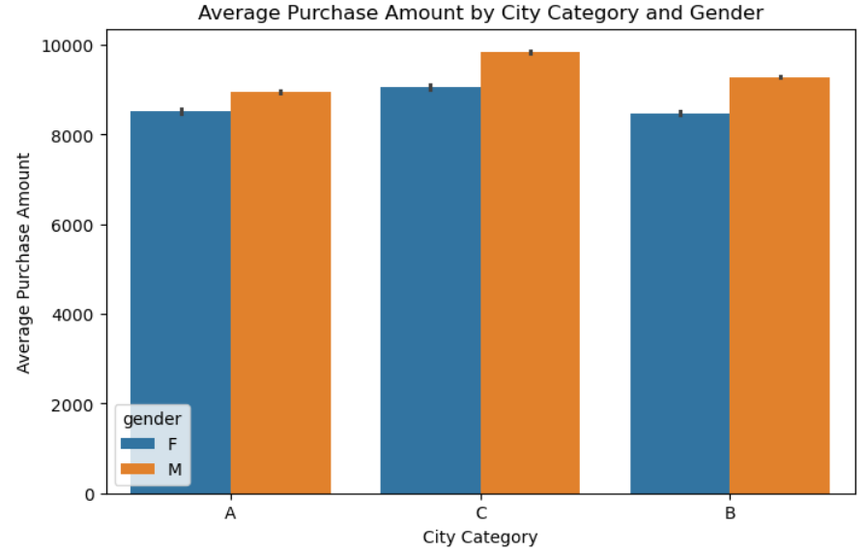
Multivariate Analysis
1. Average Purchase Amount by Age Group and Gender
3. Average Purchase Amount by Product Category and Gender
2. Average Purchase Amount by City Category and Gender
Key Observations
Male customers show higher average purchase amounts than female customers across all age groups.
City Category C has the highest average purchase amount for both genders.
Average purchase amount varies considerably across Product Category 1.
Gender differences in average purchase amount vary across product categories.

Slide 12
Pivot Table Analysis
Pivot Table - Average Purchase Amount by City Category and Gender
City Category | Female | Male
A | 8,516.90 | 8,950.11
B | 8,483.13 | 9,287.83
C | 9,058.25 | 9,838.61
Key Observations
City Category C has the highest average purchase amount for both genders.
Male customers have a higher average purchase amount than female customers in all three city categories.
Pivot tables provide a numerical summary for comparing groups.

Slide 13
Visual & Non-Visual Insights
Visual Insights
The 26–35 age group has the highest representation.
City Category B has the highest number of transactions.
Product Category 5 has the highest number of transactions.
Purchase amounts vary considerably across product categories.
Non-Visual Insights — Pivot Tables
The 51–55 age group has the highest average purchase amount for both genders.
City Category C has the highest average purchase amount for both genders.
Average purchase amount differs considerably across Product Category 1.
Male customers have higher average purchase amounts across the age-group and city-category comparisons.

Slide 14
Challenges & Learnings
Challenges Faced
Handling missing values in product category columns.
Identifying and treating purchase amount outliers.
Understanding relationships between categorical and numerical variables.
Selecting suitable visualizations for EDA.
Key Learnings
Learned how to perform data cleaning using Pandas.
Improved understanding of univariate, bivariate and multivariate analysis.
Learned to create and interpret visualizations using Matplotlib and Seaborn.
Learned how pivot tables help summarize data and identify patterns.

Slide 15
Conclusion
The Black Friday dataset was successfully cleaned and analyzed using EDA techniques.
Customer demographics, city categories and product categories show differences in purchasing behaviour.
Purchase amounts vary considerably across different product categories.
Pivot table analysis provided numerical comparisons of average purchase amounts across different groups.
The analysis provides useful insights into customer spending patterns in the retail and e-commerce domain.

